Slide 1
Homework Assignment 2
Digital Image Processing
Fall 2022

Slide 2
Problem 1 (20%)
Follow the steps outlined in Section 4.7 to repeat the experiment described in Example 4.15, pp. 271-273, on the vertical Sobel kernel shown in Fig. 4.38(a) and the test image “keyboard.tif.” You may use any existing library to compute Fourier transform.
(4%) Show the Fourier spectrum of the test image “keyboard.”
(4%) Enforce odd symmetry on the kernel. Show the kernel.
(4%) Show the result of frequency-domain filtering of the test image using the vertical Sobel kernel.
(4%) Compare your result in (c) with the result of space-domain filtering.
(4%) Show the result of frequency-domain filtering without enforcing odd symmetry on the kernel.
keyboard.tif

Slide 3
Problem 2 (30%)
Design a frequency-domain filtering algorithm to enhance the following two test images. You should clearly describe your idea and verify how it works. The grading will be based on the quality of your description and results.
Einstein.tif
phobos.tif

Slide 4
Problem 3 (20%)
Implement the interference removal technique described in Example 5.7 to understand how a notch filter works. Your program should output the interference pattern as well as the restored image.
Martian terrain.tif

Slide 5
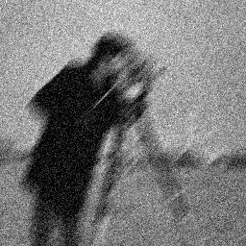
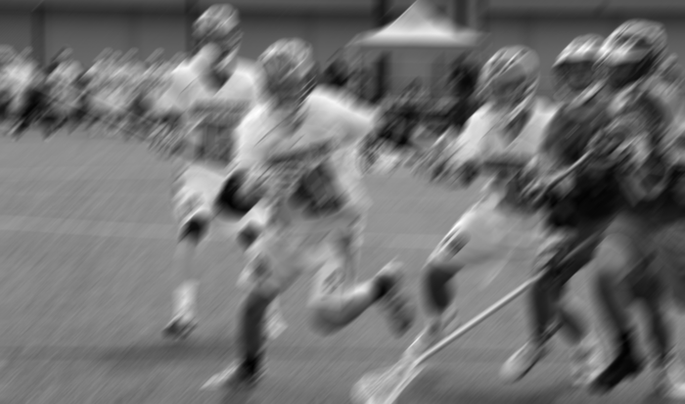
Problem 4 (30%)
The “photographer_degraded.tif” image is corrupted by motion blur and additive Gaussian noise. But we do not know the amount of motion blur and Gaussian noise. The “football player_degraded.tif” image is another degraded image. We do not have any information about the degradation. But it is reasonable to think that a Wiener filter may restore the image.
(6%) Determine the best Wiener filter for each image. You should explicitly provide its mathematical expression and parameters.
(24%) Show the restored image of each Wiener filter.
Photographer_degraded.tif
football players_degraded.tif

Slide 6
Software Package Allowed
Python 3.8+
Standard Python library
Numpy 1.21.1
Opencv-python 4.5.1
Matplotlib 3.6.0

Slide 7
Assignment Requirements
All functions in the Software Package are allowed.
Set your directory structure as follows:
r109XXXXX/
- p1.py
- p2.py
- p3.py
- p4.py
- report.pdf
- images/
- keyboard.tif, Einstein.tif, phobos.tif, etc.
- Images of program output

Slide 8
Assignment Submission Requirements
Submit to NTU COOL
Deadline:
Problem 1, Problem 2 - 11:59 PM, Monday, 10/17/2022
Problem 3, Problem 4 - 11:59 PM, Wednesday, 10/26/2022
Do NOT copy homework (code, report, results, etc.) from others

